Slide 1



S. S. Education Trust’s
S. G. Balekundri Institute of Technology
Shivabasava Nagar, Belagavi - 590010, Karnataka, India.
Approved by AICTE, New Delhi & Affiliated to VTU, Belagavi
An ISO 21001:2018 Certified Institute | 5 UG Programs are NBA Accredited
Department of Computer Science and Engineering
VISVESVARAYA TECHNOLOGICAL UNIVERSITY
Jnana Sangama, Belagavi, Karnataka
Bachelor of Engineering Internship Project
on
Front-End Web Development
Presented By
Vivek T (2BU19CS057)
Company Name
Hamdan InfoCom
Under the Guidance of
Guide Company Supervisor
Mr. Siddharth Bhatkande Mr. Mujahid Gokak

Slide 2

TABLE OF CONTENT
INTERNSHIP CERTIFICATE
INTRODUCTION
COMPANY DESCRIPTION
COMPANY PROFILE
ABOUT THE COMPANY.
TASK PERFORMED
METHODOLOGY
BLOCK DIAGRAM
HARDWARE AND SOFTWARE REQUIREMENTS
ADVANTAGES & DISADVANTAGES
INTERNSHIP DISCUSSION
APPLICATIONS
RESULT
CONCLUSION AND FUTURE SCOPE
REFERENCES

Slide 3
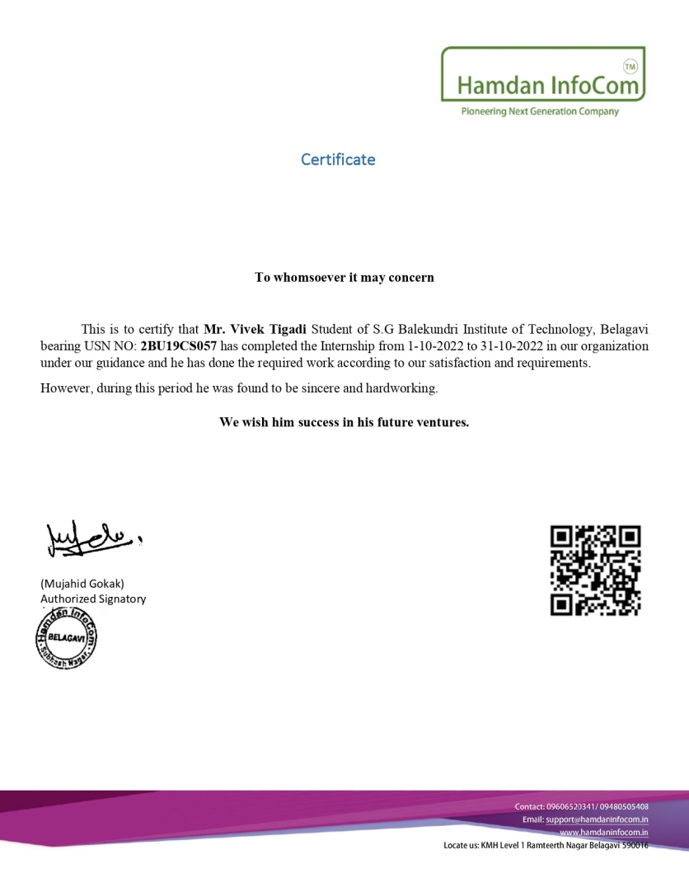
INTERNSHIP CERTIFICATE

Slide 4
INTRODUCTION
Front-end web development is the process of creating webpages and applications that are interactive and visually appealing. The Front end is the visible part of website or web application which is responsible for user experience.
The front-end part of web development is responsible for creating a visually appealing and interactive user interface.
It includes designing and implementing user interfaces, handling user events, and ensuring that the website is responsive and user-friendly on different devices.

Slide 5
COMPANY DESCRIPTION
Company Name : Hamdan InfoCom
Company supervisor : Mr. Mujahid Gokak
Company Location : Subhash nagar, Belagavi.
Hamdan InfoCom is a software startup company.
Services and clients
Clients: Venugram Sahodaya, CRM, ERP.
Internship training clients : B.Tech, MCA, BCA, Diploma.
Corporate training clients.

Slide 6
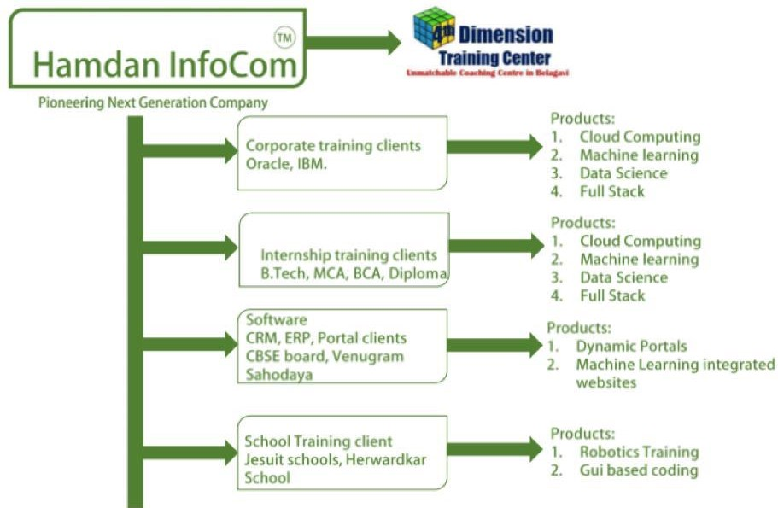
COMPANY DESCRIPTION
Services and clients

Slide 7
TASK PERFORMED
I first created the basic layout and structure of the web page using HTML. This includes defining the HTML tags, elements, and attributes that will be used to display text, images, and other media on the page.
Then applied styling and formatting to the HTML using CSS. This includes defining the layout, color scheme, font styles, and other visual elements of the page.
Then Bootstrap 4 is a popular CSS framework that provides pre-built UI components, such as buttons, forms, and navigation menus, that can be easily integrated into the web page.
JavaScript is used to add interactivity and dynamic behavior to the web page.
Overall, I created Home page and About Us page using HTML, CSS, JavaScript, and Bootstrap.

Slide 8
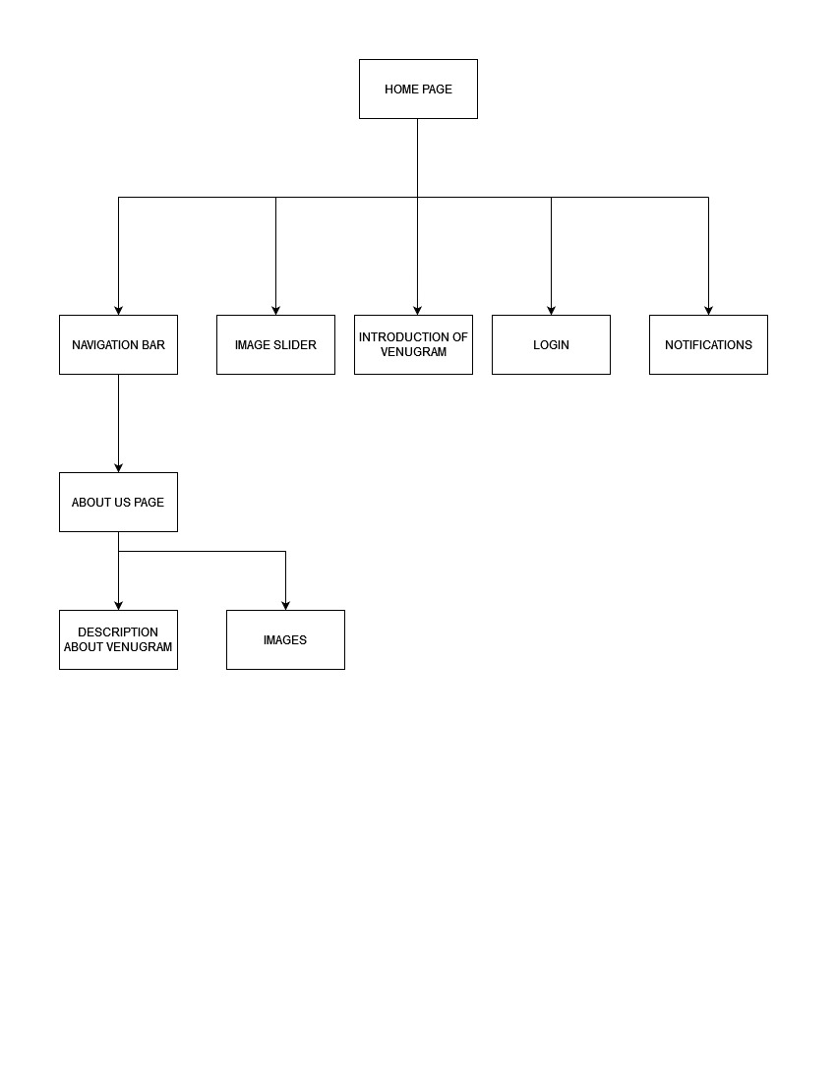
METHODOLOGY
Block Diagram:
Fig 1. Block Diagram of Home page and About us page

Slide 9
SYSTEM REQUIREMENTS
1. SOFTWARE REQUIREMENTS
TOOLS USED : VS Code
FRONT END : HTML5, CSS, JavaScript and Bootstrap
SERVER : VS code live server
OPERATING SYSTEM : Windows 7/10/11
2. HARDWARE REQUIREMENTS
PROCESSOR : Intel i3 or above
RAM : 4GB or above
HARD DISK : Min 256 GB
KEY BOARD : Standard Keyboard
MOUSE : PS/2 Mouse
MONITOR : Plug and play monitor

Slide 10
ADVANTAGES
Improved user experience: Front-end development ensures that the website is easy to navigate, visually appealing, and engaging, which leads to better user experience.
Wide Reach: With the internet being accessible worldwide websites have a vast reach, and they can target a broad audience with ease.
Cost-Effective: Building a website is relatively cheaper than other forms of advertising, such as print, TV, or radio.
Customizable: Websites can be tailored to meet specific business needs and can be designed to match the brand's aesthetics.
Enhanced functionality: Front-end development uses various frameworks and libraries to enhance the functionality of the website, making it more interactive and engaging.

Slide 11
DISADVANTAGES
Security: Web development involves handling sensitive data, and websites are vulnerable to cyber-attacks, which can lead to data breaches.
Maintenance: Maintaining a website requires ongoing effort, including regular updates, backups, and bug fixes, which can be time-consuming.
Compatibility Issues: Websites need to be compatible with different browsers and devices, which can be challenging.
Slow Load Times: Websites that are slow to load can negatively impact user experience, leading to a higher bounce rate.

Slide 12
APPLICATIONS
Website design: Front-end web development is often used to design the layout and structure of a website, including choosing colors, typography, images, and other visual elements.
E-commerce development: Front-end web development is often used to create the user interface and shopping cart functionality of e-commerce websites.
Web animations and effects: Front-end web development is often used to create animations, transitions, and other visual effects on websites.
Responsive web design: Front-end web development is used to design websites that are optimized for different screen sizes, including desktops, laptops, tablets, and smartphones.

Slide 13
INTERNSHIP DISCUSSION
HTML: (Hypertext Markup Language) It is the standard markup language used to create web pages. I learnt how to structure and organize content using HTML.
CSS: (Cascading Style Sheets) It is used to style and format web pages. I learnt how to use CSS to control the layout, typography, and colors of web pages.
JavaScript: JavaScript is a programming language used to create dynamic and interactive web pages. I learnt the basics of JavaScript to add interactivity and functionality to web pages.
Bootstrap: It is a popular front-end framework that makes it easy to create responsive and mobile-first web pages and applications.
Responsive Design: Responsive design is a technique used to create web pages that adjust to different screen sizes and devices.

Slide 14
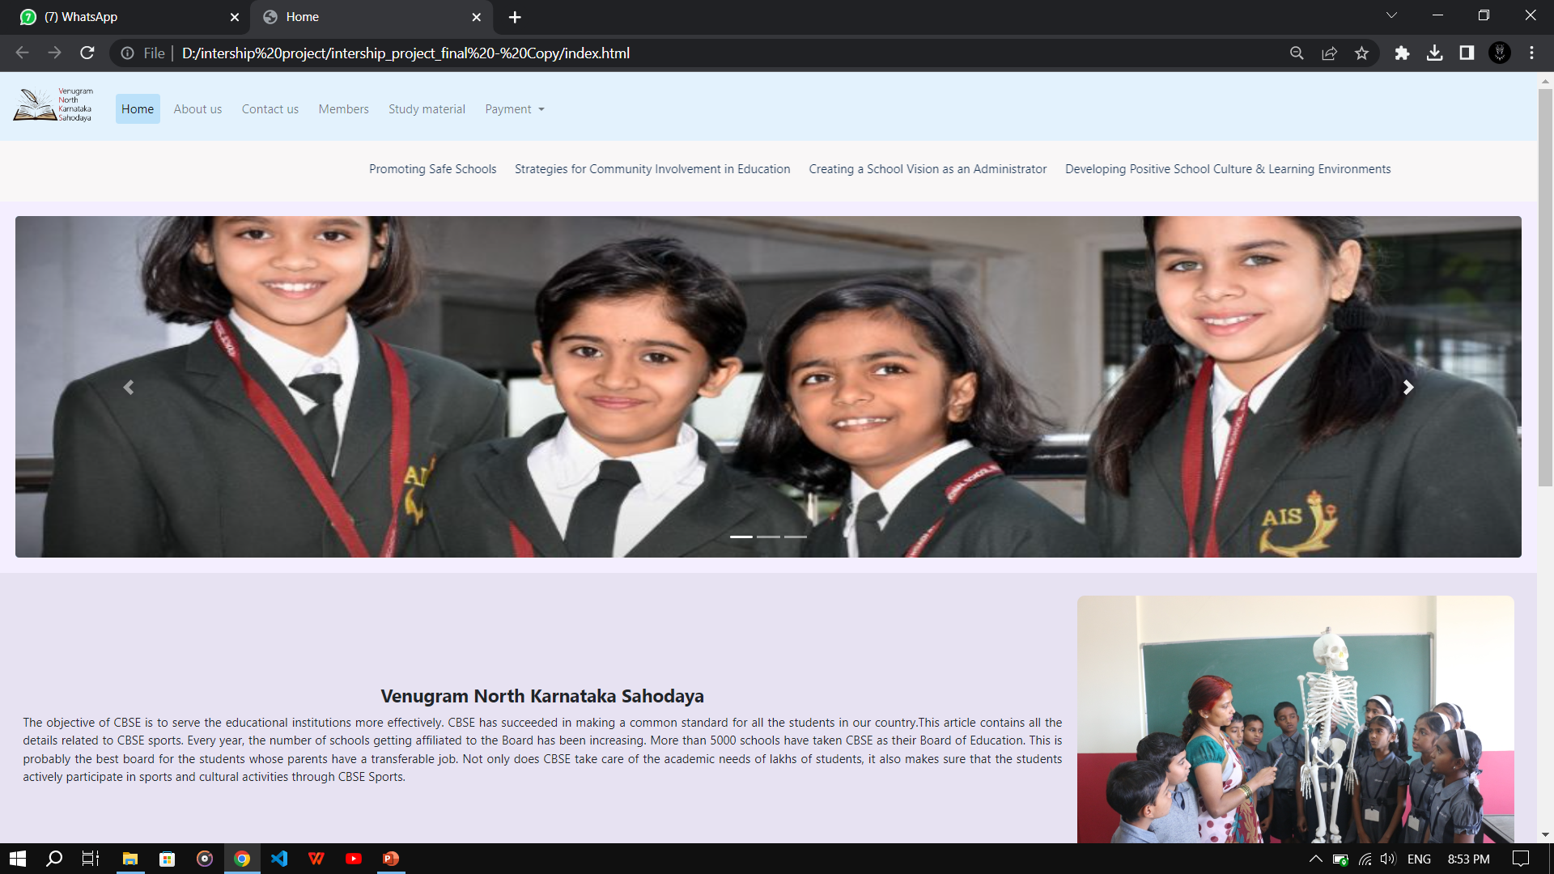
RESULTS
Home page

Slide 15
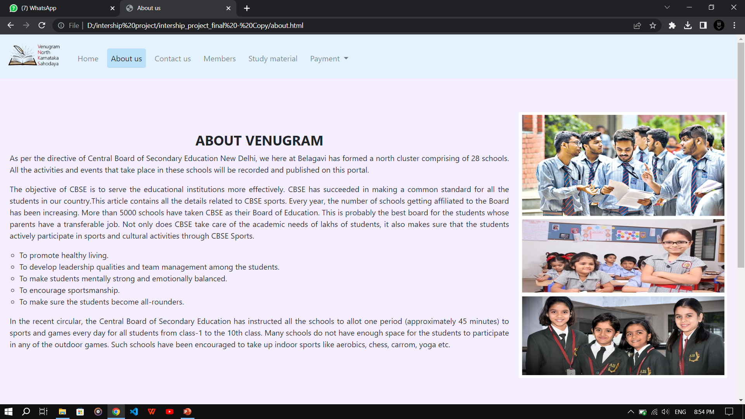
RESULTS
About us page

Slide 16
CHALLENGES FACED DURING THE INTERNSHIP
The biggest challenge faced in front-end designing is evaluation of end-user requirements and optimizing the design accordingly.
End users are diverse and so are their requirements.
Browser Compatibility: Web pages and applications must work consistently across different browsers and devices. It can be challenging to ensure that web pages are compatible with all major browsers and devices.
Responsive Design: Responsive design is an essential aspect of front-end web development, and we must learn how to design and develop web pages that work well on different screen sizes and devices.

Slide 17
CONCLUSION
Front-end web development is an essential aspect of web development that involves designing, coding and modifying the user interface of website. It is the part of the development process that involves creating the visual elements of a website that users interact with.
Front-end web development is a constantly evolving field that requires a combination of technical expertise, creativity, and problem-solving skills.
With the rise of mobile devices and the increasing demand for fast, secure, and responsive websites and web applications, front-end web development has become even more challenging.
Front-end web development is a crucial aspect of businesses today as websites and web applications have become essential tools for marketing and communication.

Slide 18
FUTURE SCOPE
Increasing demand: With the advent of new technologies and devices, the demand for front-end developers is increasing day by day. As more and more businesses are moving online, the need for skilled front-end developers is also increasing.
Increased demand for responsive design: As more and more people are accessing websites through mobile devices, responsive design has become crucial. Front-end developers need to ensure that the websites they develop are responsive, and the user experience is seamless across all devices.
User experience: User experience is critical in today's world, and front-end development plays a crucial role in designing interfaces that are intuitive, interactive, and easy to use. This has become even more important as more and more businesses are moving online.

Slide 19
REFERENCES
[1] S K. Patel, Developing Responsive Web Applications, 2018.
[2] S. Murugesan, Y. Deshpande, S. Hansen et al., Web Engineering: a New Discipline for Development of Web-Based Systems[J], 2018.
[3] A.V. Akhil Krishna, Dr. Padmashree T," A Survey on Current Technologies for Web Development",International Journal of Engineering Research & Technology (IJERT),June 2020.
[4] Nian Li1, Bo Zhang1,"The Research on Single Page Application Front-end development Based on Vue ", 2021.
[5] Arnav Awasthi, Shubham More, Warren Viega,"Research and Analysis of the Front-end Frameworks and Libraries in Web Development", IJRASET, 2022.

Slide 20
THANK YOU

